Slide 1

EUS Survey Program Manager Survey Design Exercise
Neil Yetz, M.S., M.P.H.
10/02/2025

Slide 2
Objectives
Assessment approach, logic, and assumptions
Answer Key Questions:
Using the data provided in the Mechanical_One_Line tab, the data dictionary, and the accompanying RBSA user guide, please assess how well or poorly conclusions about HVAC equipment in manufactured homes can be made.
Based on your assessment, what improvements could be made to the upcoming RBSA?
Key considerations around design, scope, and budget for leadership to consider
Gap analysis. What other data and information would you recommend seeking out to inform your assessment?
What questions came up as you developed your business case?

Slide 3
Assessment Approach, Logic, & Assumptions

Slide 4
Assessment: An epidemiologic approach
Methodology
Survey Design
Research Questions / Hypotheses
Data Quality
Analysis
Limitations
Conclusions

Slide 5
2022 Residential Building Stock Assessment (RBSA) Methodology
The 2022 RBSA database is to provide a current, robust, and representative characterization of the existing residential single-family and multi-family building stock in the Northwest.
Data is collected from single & multi-family residences in urban/rural regions of Idaho, Montana, Oregon, & Washington
Data can be further divided by building type, including:
Single family home
Apartment
Duplex/Triplex/Fourplex
Townhome
Manufactured home

Slide 6
2022 RBSA Limitations
Demographic data is not supported
Multi-family buildings in Idaho and Montana is small
Analysis of n < 10 are not recommended
Usually a consequence of overly specific analyses
Manufactured homes analyses cannot be compared to previous RBSA studies
Does not support analysis by manufacturer or regional availability of equipment

Slide 7
2022 RBSA Limitations
Demographic data is not supported
Multi-family buildings in Idaho and Montana is small
Analysis of n < 10 are not recommended
Usually a consequence of overly specific analyses
Manufactured homes analyses cannot be compared to previous RBSA studies
Does not support analysis by manufacturer or regional availability of equipment

Slide 8
Survey Summary

Slide 9
Survey Sample Collection Area
Sampled area
N = 2,279

Slide 10
Responses by State
N = 2,279

Slide 11
Rural vs Urban
N = 2,279

Slide 12
Responses by Residence Type
N = 2,279 | Multi-Family Residence (N =369) | Apartment Building (3 or fewer floors) | 155
 |  | Apartment Building (4 to 6 floors) | 141
 |  | Apartment Building (More than 6 floors) | 73
 | Single Family Residence (N = 1,902) | Duplex, Triplex, or Fourplex | 122
 |  | Manufactured - Double Wide | 26
 |  | Manufactured - Single Wide | 8
 |  | Single Family Detached | 1703
 |  | Townhome or Rowhome | 51

Slide 13
Key Question 1:
Using the data provided in the Mechanical_One_Line tab, the data dictionary, and the accompanying RBSA user guide, please assess how well or poorly conclusions about HVAC equipment in manufactured homes can be made.

Slide 14
Manufactured homes are the least sampled building type
N = 2,279

Slide 15
Manufactured Home Collection Area
Sampled manufactured home
N = 34

Slide 16
Manufactured Homes by State
Total | State | Manufacture Home Type | n
N = 34 | Idaho (N = 18) | Single Wide | 14
 |  | Double Wide | 4
 | Montana (N =2) | Single Wide | 2
 |  | Double Wide | 0
 | Oregon (N = 5) | Single Wide | 4
 |  | Double Wide | 1
 | Washington (N = 9) | Single Wide | 6
 |  | Double Wide | 3

Slide 17
Manufactured Homes by State: N < 10
Total | State | Manufacture Home Type | n
N = 34 | Idaho (N = 18) | Single Wide | 14
 |  | Double Wide | 4
 | Montana (N =2) | Single Wide | 2
 |  | Double Wide | 0
 | Oregon (N = 5) | Single Wide | 4
 |  | Double Wide | 1
 | Washington (N = 9) | Single Wide | 6
 |  | Double Wide | 3

Slide 18
Key Question 2:
Based on your assessment, what improvements could be made to the upcoming RBSA?

Slide 19
Manufactured homes are more present in rural areas
N = 34

Slide 20
Rural Areas for Oversampling
2022 RBSA Sampled Rural Area
Unsampled Rural area*
*“Rural” is defined as USDA RUCC classification >3.
RUCC info: https://www.ers.usda.gov/data-products/rural-urban-continuum-codes
Notes:
RUCC = Rural Urban Continuum Code

Slide 21
Key considerations around design, scope, and budget for leadership to consider
Budget Consideration for next survey:
Identify and Oversample Manufactured homes
Strategy:
Oversample already surveyed areas
Identify and recruit from more rural areas
Utilize more modes of survey distribution:
Online surveys
Telephone calls
Identify survey distributors that specialize in rural areas
Weighting manufactured home data is also an option
However, a larger n is still necessary (n >10)

Slide 22
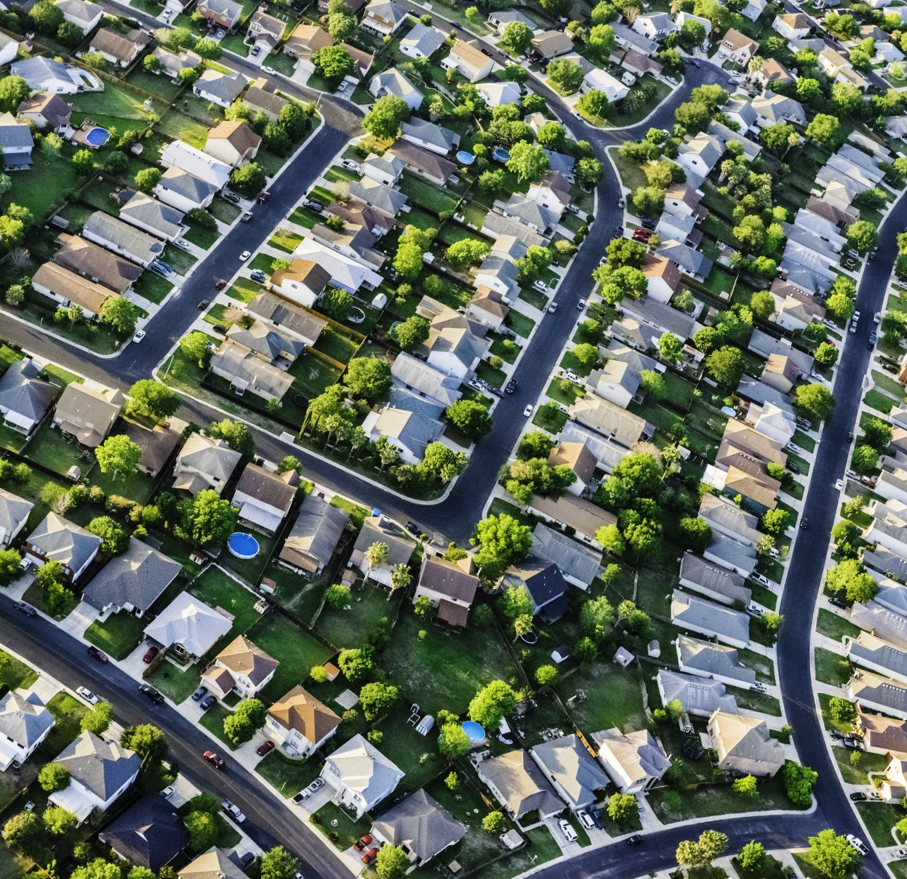
Gap analysis. What other data and information would you recommend seeking out to inform your assessment?
Require up to 5x more manufactured home survey responses for future analyses
More information of manufacture home building distribution required
Demographic variables may help to identify manufactured home trends

Slide 23
What questions came up as you developed your business case?
What methods and modes of survey distribution were used for data collection?
What other limitations and challenges are often faced by the RBSA survey distribution?
Should I be aware of potential biases in data?
i.e. Are certain resident types more likely to respond to the RBSA surveys?

Slide 24
Thank You!
Questions?

